Slide 1
Impact of COVID-19 on ABC Company’s Parcel Delivery Business
Final Project Group Assignment
Raihan Reza, Syed Hasan (Group-5)
COMP 603, Fall 2024
December 16, 2024

Slide 2
Executive Summary
Overview
The parcel delivery trends from 2018 to 2021 reveal significant growth in 2020, primarily driven by the COVID-19 pandemic. During this period, there was an exceptional increase in parcel delivery volumes starting from Week 11 to Week 53 of 2020. The pandemic triggered behavioral changes towards online purchases and deliveries, which directly impacted ABC Company's operations. While the overall business grew, specific challenges, such as a decline in the 'Large Customer Group,' were observed.
Volume Surge: The highest parcel delivery volume occurred in 2020.
COVID-19 Period (Week 11–Week 53, 2020): Steady volume increase was noted, corresponding to:
Weeks 11–21: Sharp rise due to early pandemic-related lockdowns, online shopping and product transfer.
Weeks 45–52: Seasonal peak during the holiday season (consistent across all years).
The 2020 holiday peak did not show abnormal growth but reflected continued demand for goods transfers and online purchasing.

Slide 3
Executive Summary
Other than the 'Large Customer Group', all customer groups showed positive growth in 2020 over 2019.
Growth exceeded the ISGR (Industry Standard Growth Rate) of 11.4%.
More than 50% of customers within each group grew at a rate higher than the ISGR.
The Enterprise Group demonstrated the highest percentage growth.
COVID-19 Impact: Pandemic-like situations have a positive relationship with parcel delivery services, creating significant business growth opportunities.
Customer Behavior: Behavioral shifts towards online purchasing, work-from-home dynamics, and stimulus programs (e.g., C.E.R.B) acted as primary drivers for volume increases in 2020.
Customer Retention Focus: Loss of small and medium customers highlights the need for better retention strategies and targeted outreach.
Segment Performance: Special attention is required for the Large Customer Group, which exhibited negative growth in contrast to other segments.

Slide 4
Background and Objectives of the Study
Background:
The COVID-19 pandemic impacted Canadian businesses in various ways. Some businesses saw unprecedented growth due to increased e-commerce activity, while others found their product or service revenue plummeted. At ABC Company, there are customers from all sectors who have experienced COVID in their unique ways.
Objectives:
Analyze the dataset (COVID_Parcel_Business.csv) that contains customer IDs, the year, the week number, and the number of parcels shipped that week.
With appropriate analysis, summarize the findings that are important for the business.

Slide 5
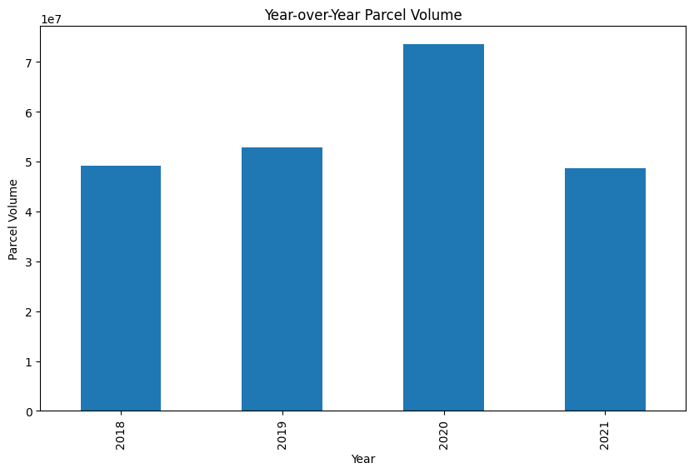
Impact of COVID on ABC Business during Pre and Post COVID period
Among the 4 years from 2018 to 2021, in 2020 there was the highest parcel delivery volume
During the COVID observation period from Week 11 to Week 53 o 2020 business experienced steady increase

Slide 6
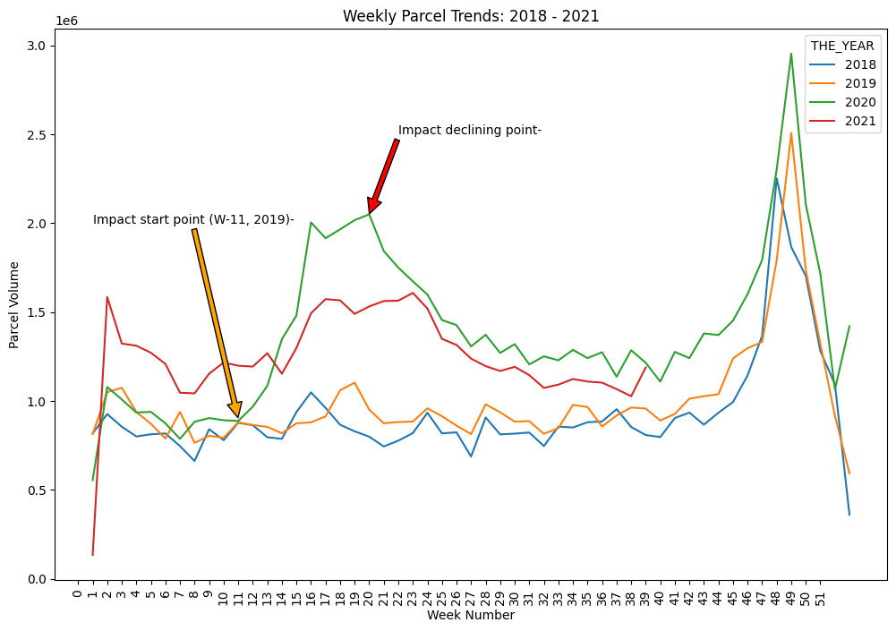
Impact of COVID on ABC Business during Pre and Post COVID period
The green line (2020) shows an exceptional increase in parcel volume around Weeks 11 to 21, corresponding to the early pandemic period when lockdowns boosted online shopping
Other than 2020, parcel delivery volume showed a generic/organic growth and common seasonality

Slide 7
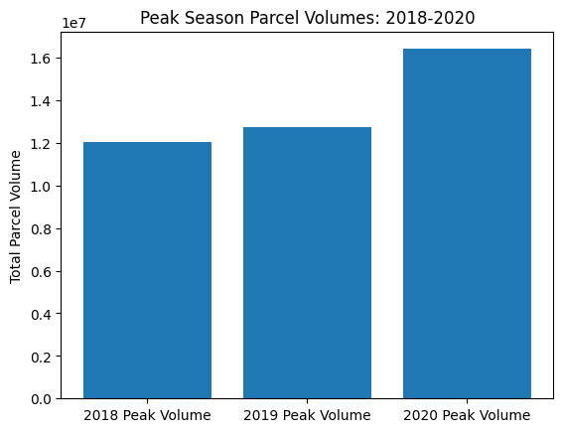
Peak Season: Observations
All years displayed a peak starting from Week 45 to the end of the year (Highest during Weeks 48–52), likely due to the holiday season during increased parcel deliveries.
However, 2020 peak season did not show any abnormal growth, except some impact of behavioral change towards online purchase, goods delivery and product transfers

Slide 8
Possible Reasons for Sharp Increase in W11-W21 2020
Week 11: Pandemic declared
People started accumulating necessary goods
Week 12: Work From Home
Indication for further delay of normalcy boosting online purchase
Week 12-13: Canada/USA Border restrictions
Assumption of scarcity of Imported goods led to further rise of online purchase through delivery service
Week 13: Canada Post COVID delivery standard
Further strengthening of delivery service
Week 15: C.E.R.B Launched
Response benefit lashed further purchase power leading to more online order and accumulation of goods

Slide 9
Customer group’s Growth during 2019-2020
Overall customer growth in different Customer Groups:
Enterprise (>500K in 2019) | 11.5%
Large (200K-500K in 2019) | -4.5%
Medium(10K-200K in 2019) | 18.0%
Small (1K-10K in 2019) | 18.7%
Other than the Large Customer Group, all other groups showed positive growth in 2020 from 2019 (more than the ISGR (11.4%) in terms of parcel delivery volume.

Slide 10
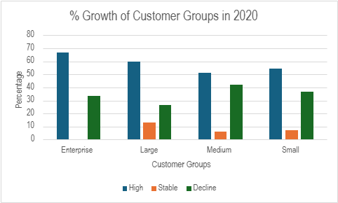
Percentage of customer group’s Growth during 2019-2020
 | High/Growing (>ISGR) | Stable/Moderately Growing (= 0% to ISGR) | Declining (<0%)
Enterprise | 66.67% | - | 33.33%
Large | 60.00% | 13.33% | 26.67%
Medium | 51.15% | 6.32% | 41.95%
Small | 54.30% | 7.33% | 36.74%
More than 50% Customers within each customer group has grown at a rate more than ISGR ( Enterprise Group showing the highest percentage)

Slide 11
Addition and Churn/Lost of Customers during 2019-2020
There have been 15 customers lost during 2020 (who were in the 2019 customer list), among them
1 is from ‘Medium’ customer group
14 are from ‘Small’ customer group
No new customer has been added in 2020.

Slide 12
Overall impact of COVID on volumes and revenue by customer group
 | Volume |  | Revenue ($)
 | 2019 | 2020 | 2019 | 2020 | % Growth
Enterprise | 9,306,896 | 10,374,676 | 159,706,300 | 178,029,400 | 11.47%
Large | 1,173,044 | 1,120,701 | 21,419,780 | 20,464,000 | -4.46%
Medium | 1,926,935 | 2,273,566 | 38,153,310 | 45,016,610 | 17.99%
Small | 715,941 | 850,074 | 15,120,670 | 17,953,560 | 18.74%

Slide 13
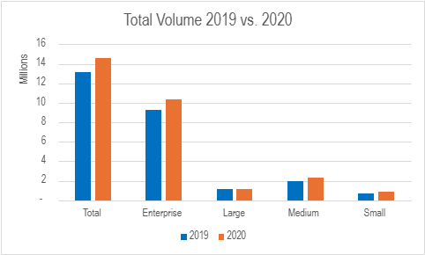
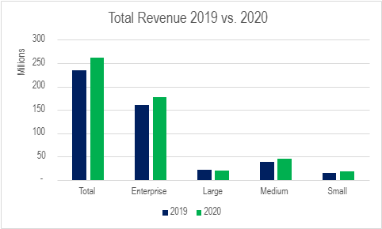
Overall impact of COVID on volumes and revenue by customer group
From 2019 to 2020, both Volume and Revenue have shown a steady positive increase in each segment other than the ‘Large’ customer group.

Slide 14
Recommendations
Need to find root-cause for negative growth of ‘Large’ customer group during COVID period
Take necessary measures to accommodate business growth opportunity in future as there is a positive relationship between COVID-like situations (Pandemic) and Parcel delivery service

Slide 15
Thank You

